Slide 1



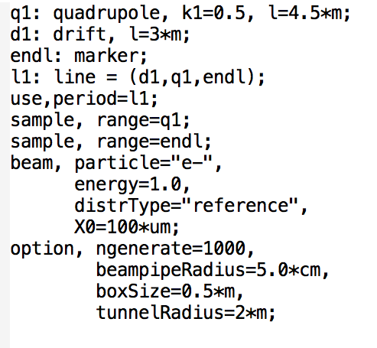
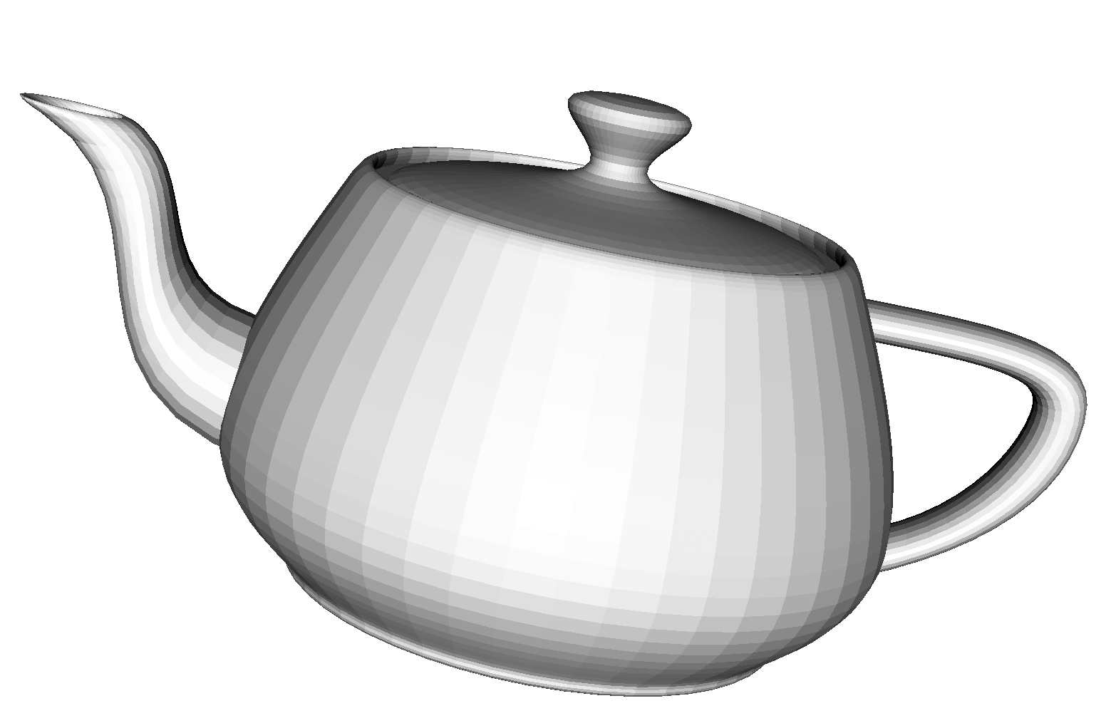
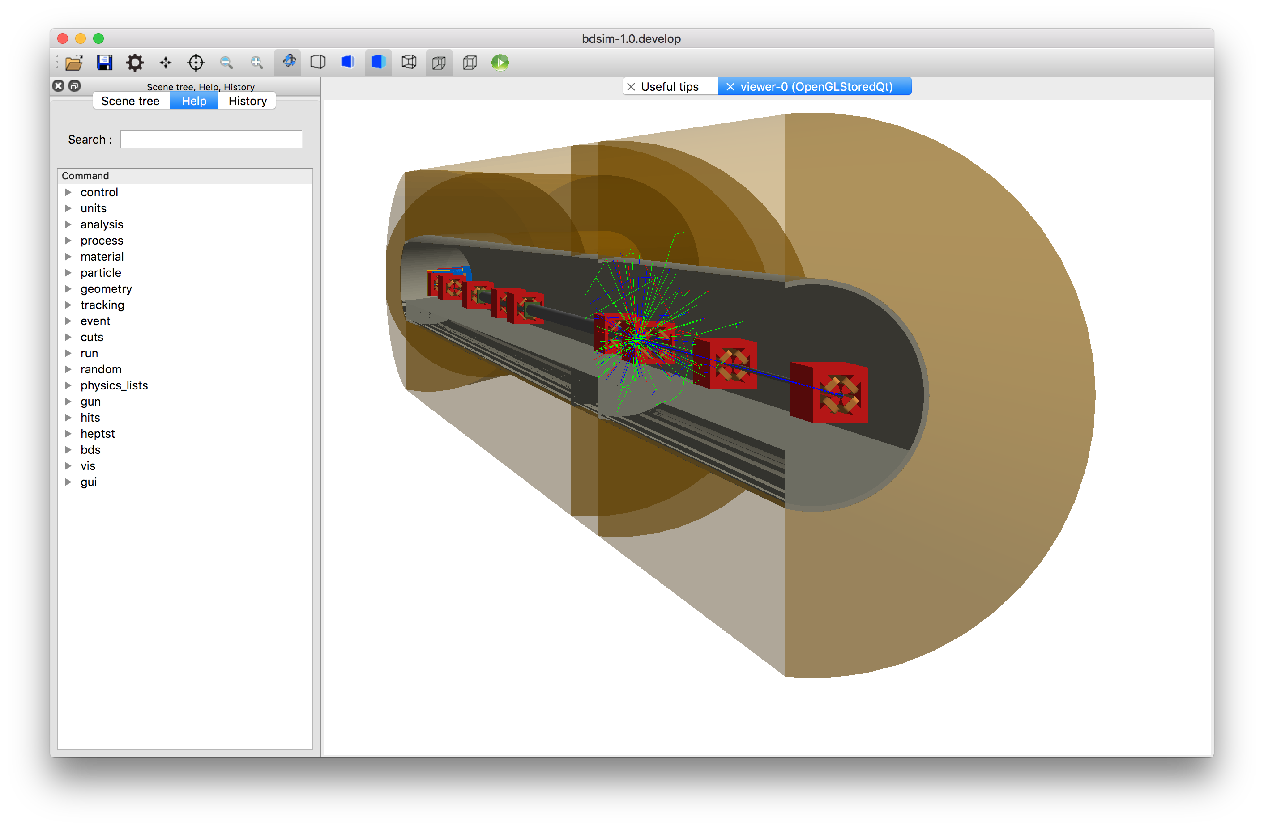
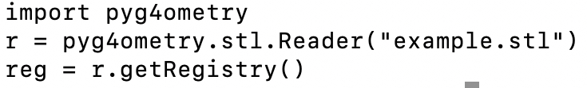
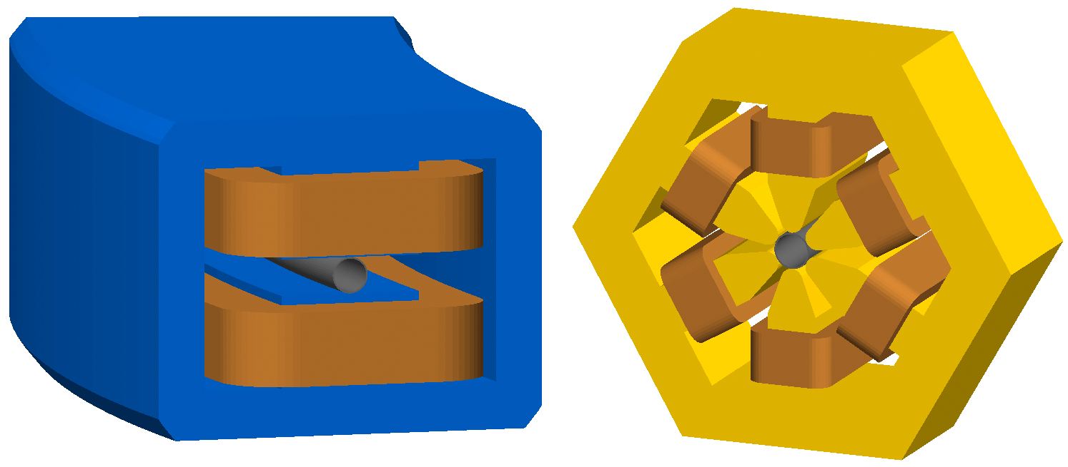
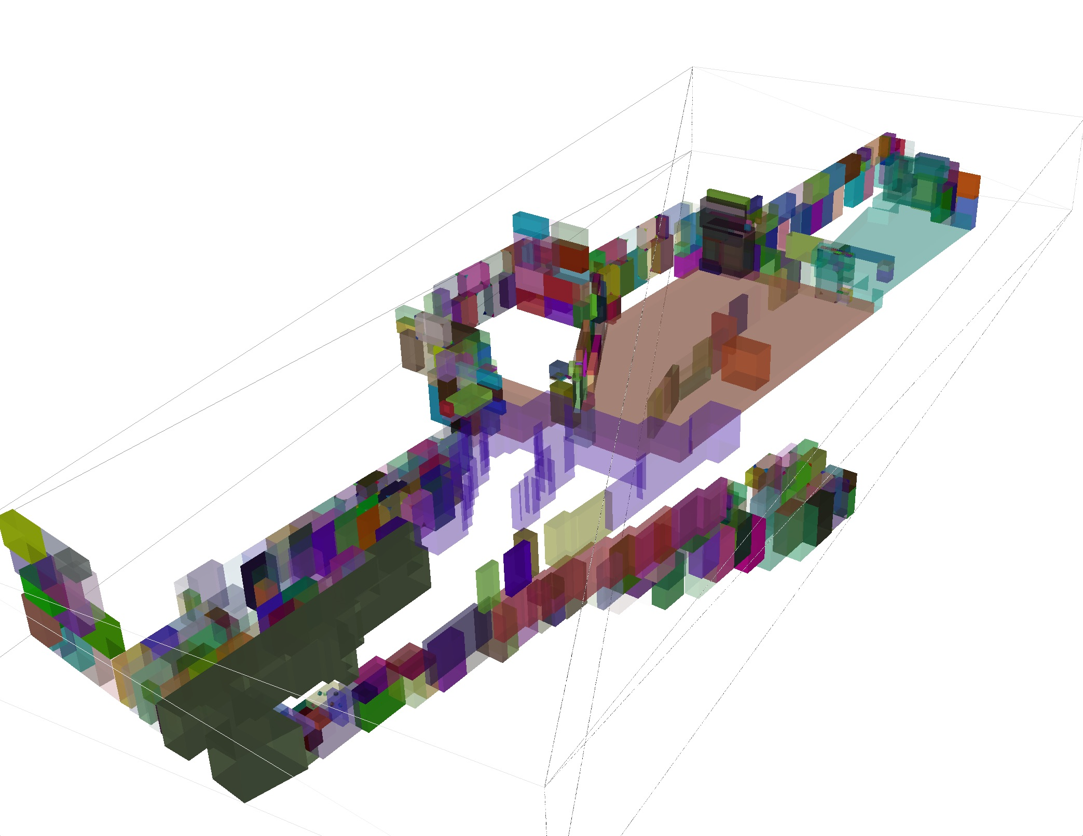
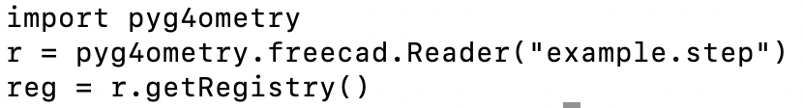
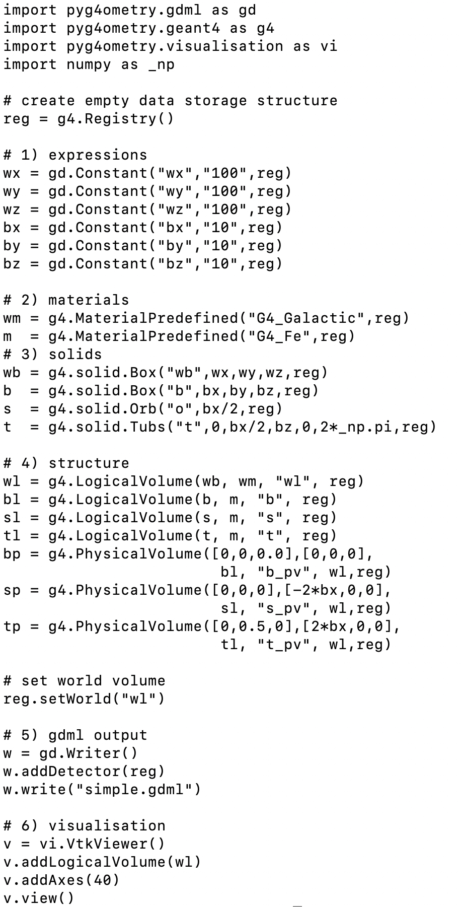
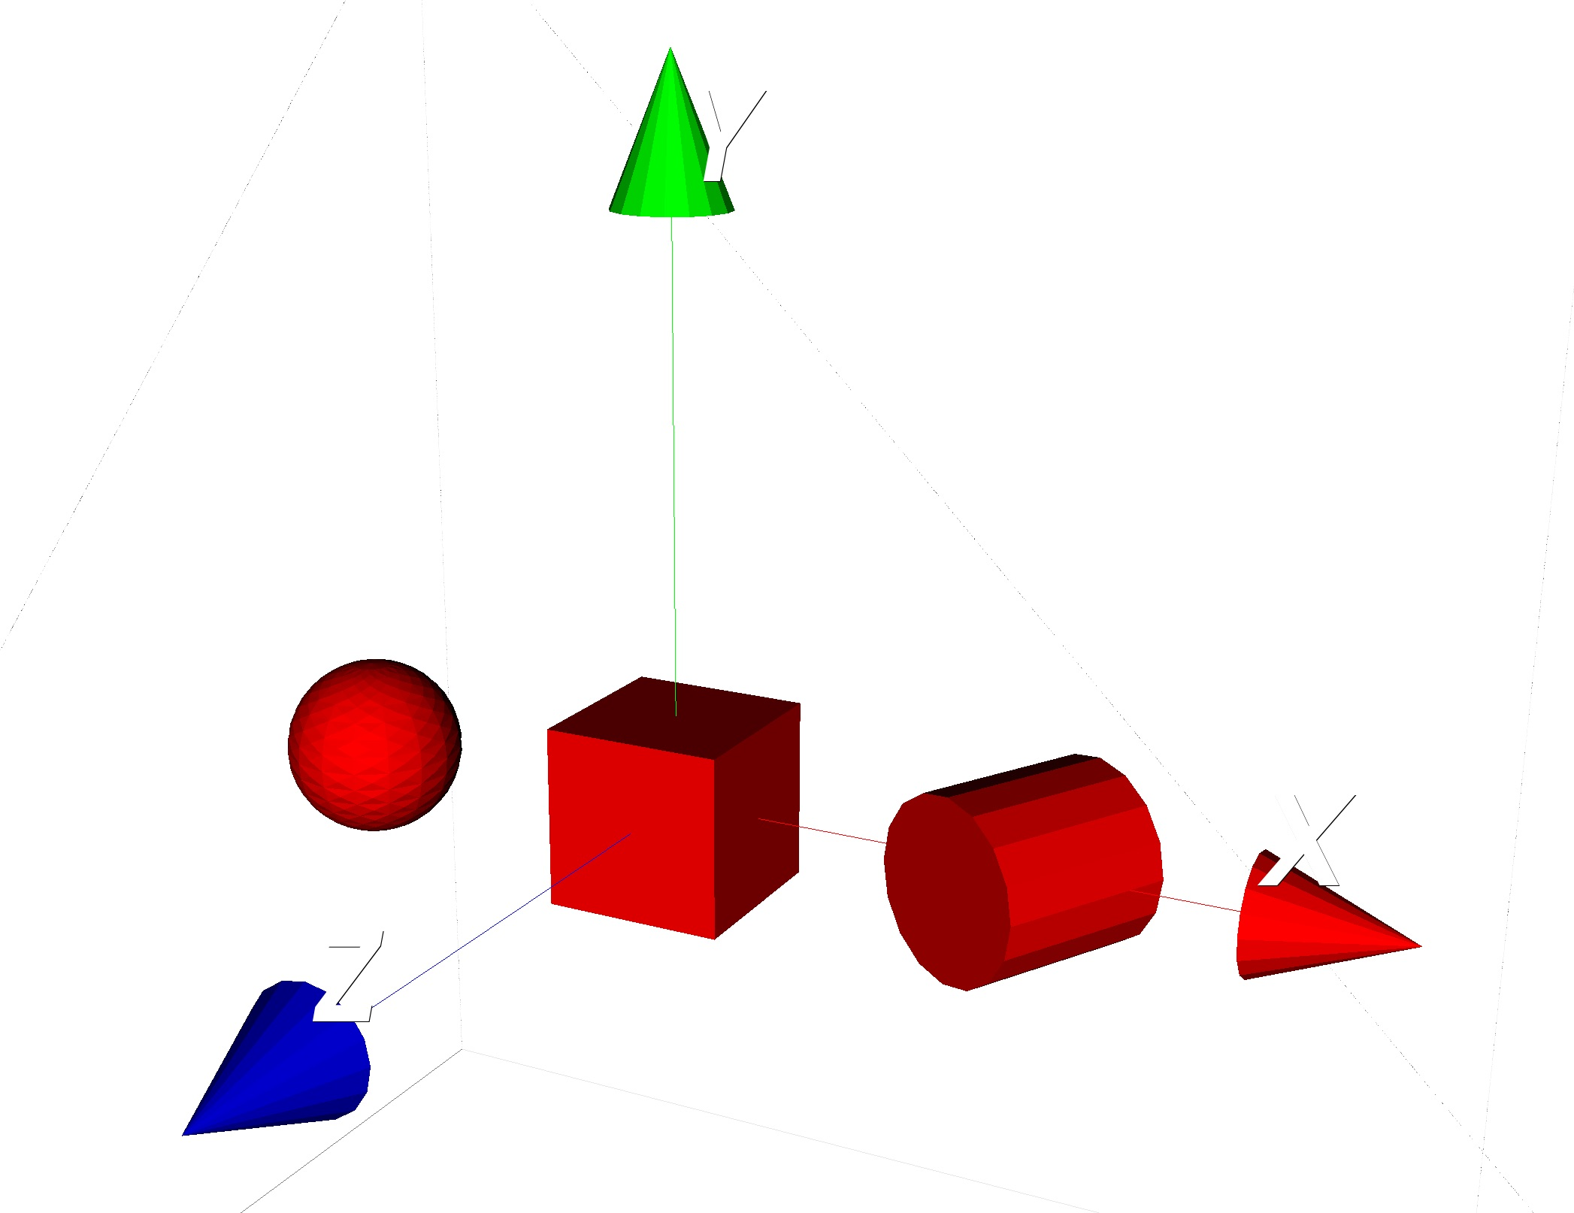
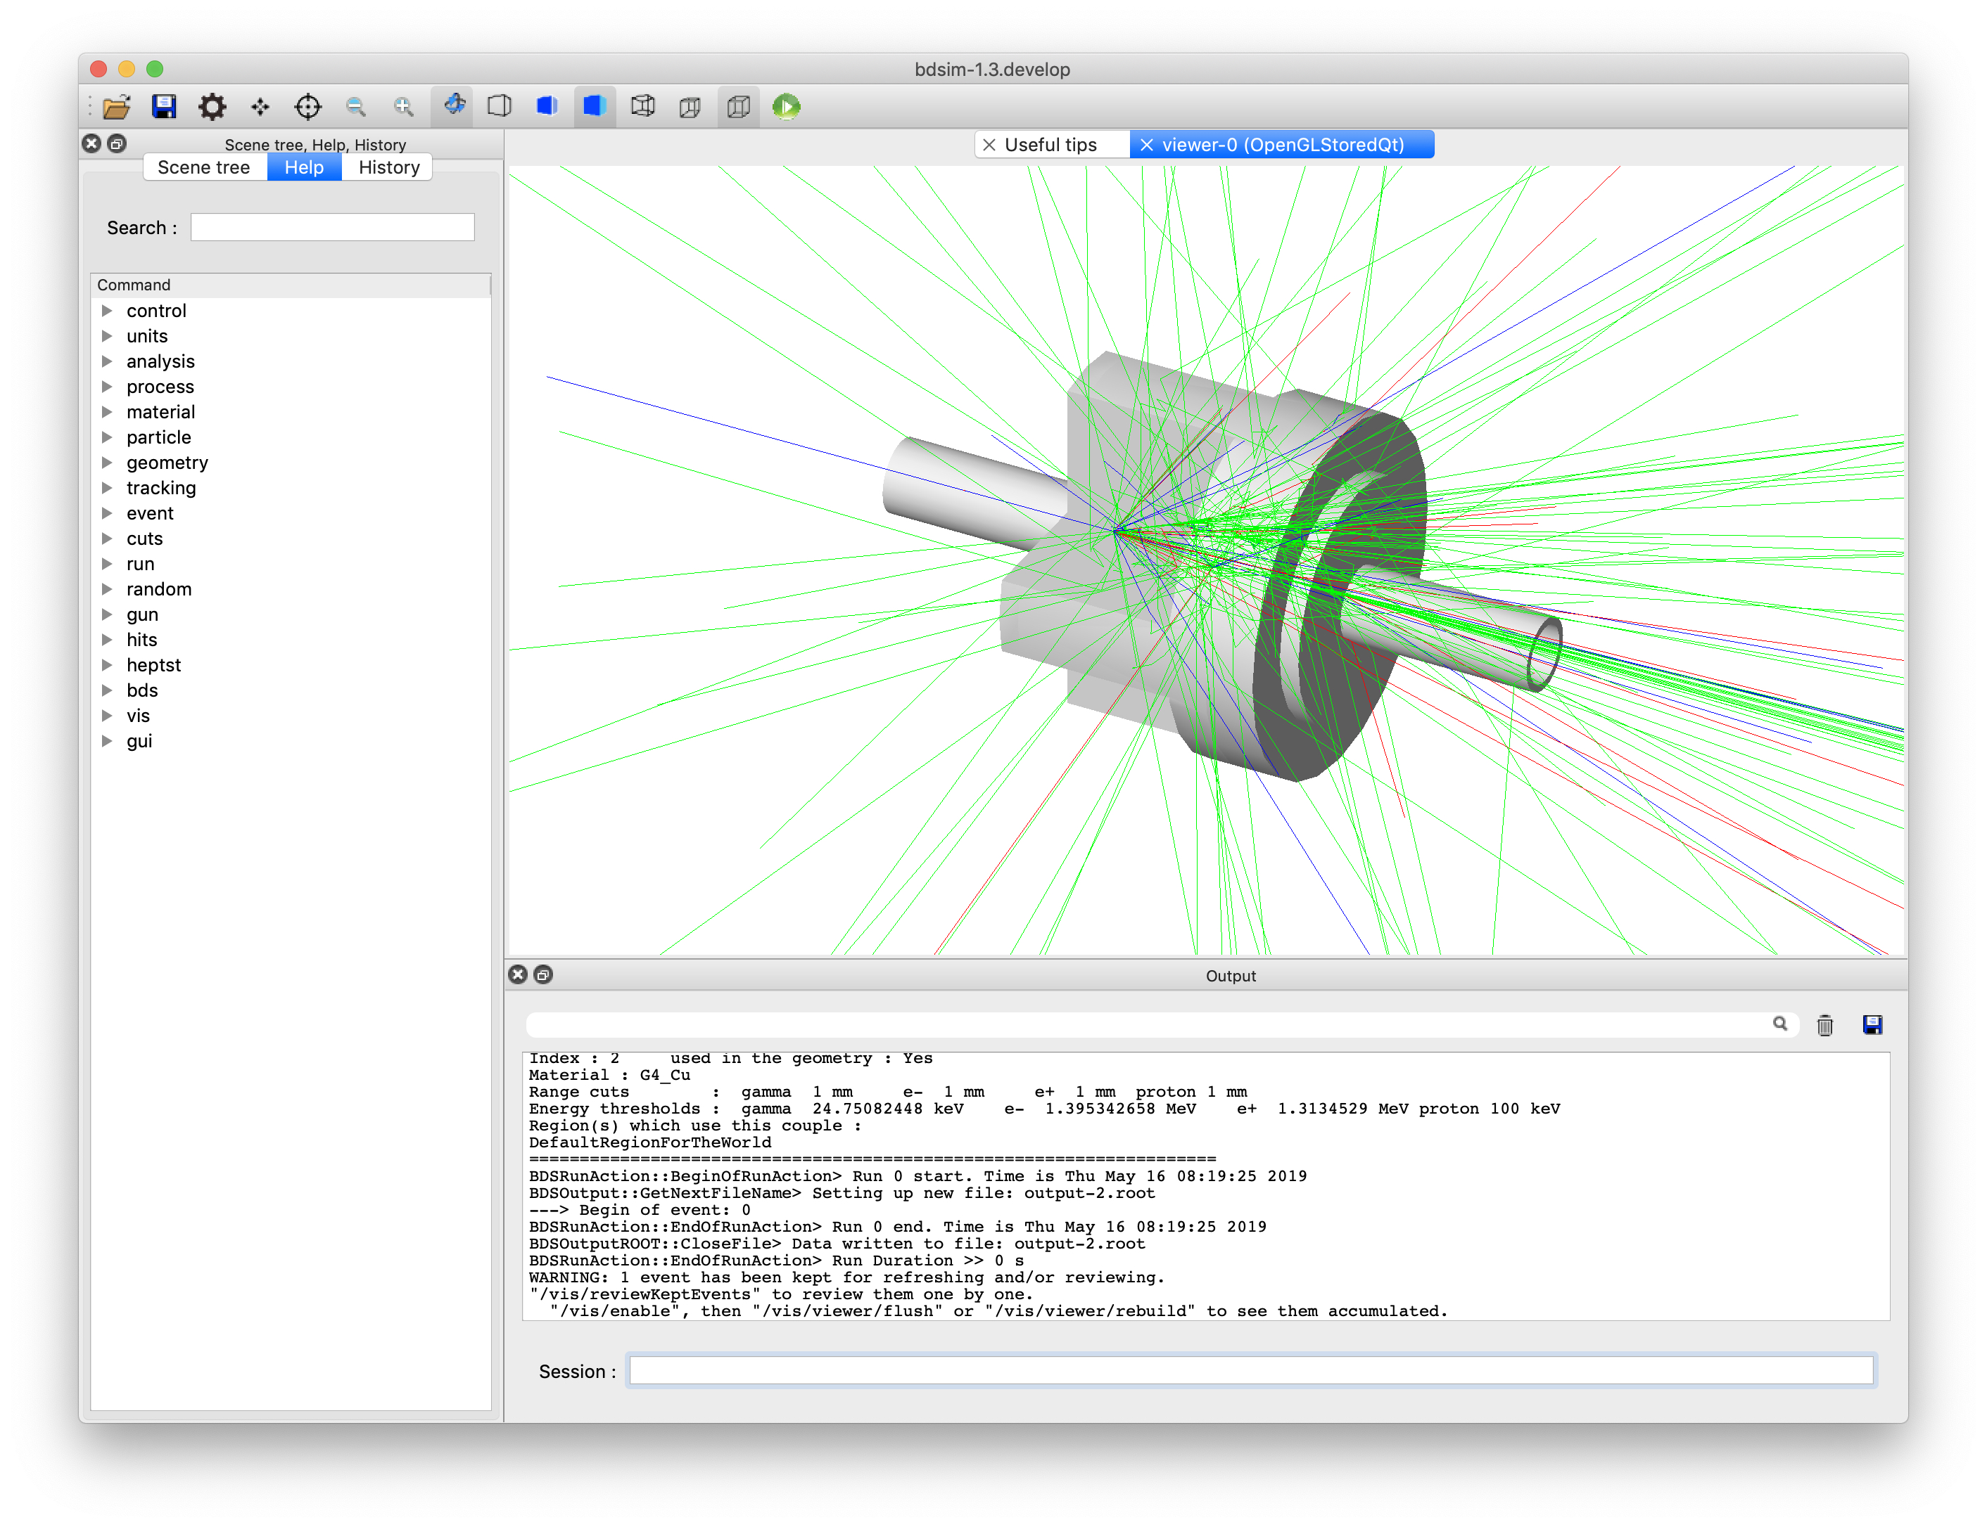
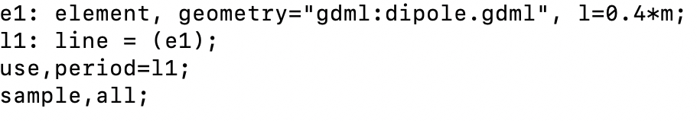
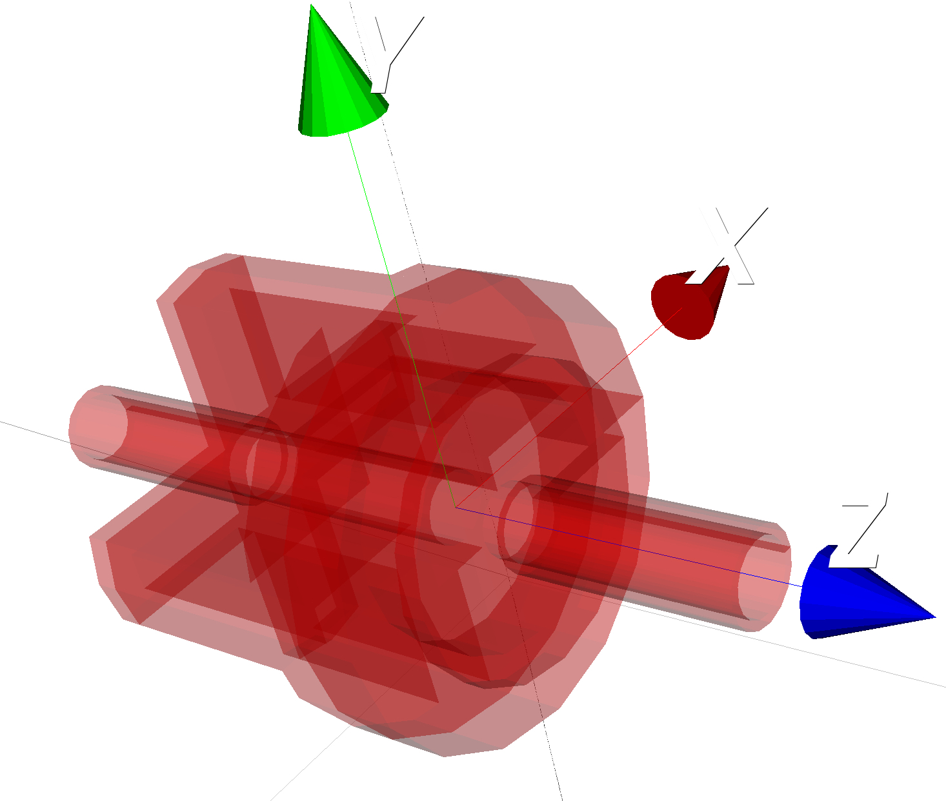


PYG4OMETRY : A TOOL TO CREATE GEOMETRIES FOR GEANT4, BDSIM, G4BEAMLINE AND FLUKA FOR PARTICLE LOSS AND ENERGY DEPOSIT STUDIES
S. T. Boogert, A. Abramov, J. Albrecht, G. L. D'Alessandro, L. Nevay, W. Shields, S. Walker
c
STL geometry loading
www.pp.rhul.ac.uk/bdsim
STL file format describes a raw unstructured triangulated surface mesh, where the surface normal is defined by the ordering of the vertices.
Simulate beam loss and detector backgrounds
Python tools to convert from MADX, MAD8 & Transport
Track primaries and secondaries
Full range of physics processes from Geant4
Example input file.
STL carries no material visualization information. This has to be added by the user for each STL mesh. The STL can be then written as GDML
Example visualization of a classic STL file
BDSIM interactive Qt viewer showing lattice and secondaries.
Example dipole and sextupole geometry.
Freecad geometry loading
Pyg4ometry
A common CAD/CAM format used for exchange of engineering information. A pyg4ometry uses FreeCAD a open source CAD package. The conversion steps in pyg4ometry are
Write STEP/STL file
Load STEP file using FreeCAD
Determine parts and assemblies
Convert parts to triangular meshes
Write as GDML
bitbucket.org/jairhul/pyg4ometry
Requirements for a geometry package
Rapid creation
Various sources for geometry (CAD, STL, Python, GDML, Fluka)
Reduction of errors (e.g. solid overlaps)
Programmatic generation of geometry (allowing converters to be written.
Compositing geometry together to form a complete simulation
Key implementation details
Programmatic generation of geometry in PYTHON
Primary input/output format is GDML
Parsing GDML expressions vising ANTLR
Visualization based on VTK
CAD/CAM file conversion based on FreeCAD/OpenCASCADE
c
Python geometry definition
Need to script geometry in PYTHON. Use the PYTHON interpreter to check the syntax via classes that match Geant4
Example a conversion from STEP file description of the shielding of the CERN East Area T8 and T11 test beam lines to GDML. Each part is given a randomly assigned colour to clearly indicate the structure of the shielding.
Example python geometry defintion
6 stages of PYTHON script, 1) expressions, 2) materials, 3) solids, 4) structure, 5) GDML output and 6) visualization.
Geometry running in Geant4/BDSIM
Sphere solid
Box solid
Tubs solid
The pyg4ometry can be directly written to GDML and loaded into a Geant4 application.
Sensitive detectors and scorers can be added to volumes
Three dimensional extent can be included to aid inclusion in other simulations
Output of pyg4ometry python script
Example of a cavity beam position monitor in BDSIM
Summary and future work
Pyg4ometry is a powerful and easy to use package to rapidly develop material geometries for accelerator beam line simulations. Currently existing geometry can be loaded from GDML, STEP, STL and FLUKA files. We introduce a new python interface to create geometry and adapt existing geometry. Given the simple structure and PYTHON base of pyg4ometry the following extensions are being considers
An alternative C++ output writer to include pyg4ometery directly into Geant4 application
FLUKA reading and writing (also other MC geometry formats)
Graphical user interface to pyg4ometry to allow non-programmers to create geometry.
Example of a cavity beam position monitor
* stewart.boogert@rhul.ac.uk
(1) John Adams Institute at Royal Holloway, University of London, Egham, Surrey, TW20 0EX, UK
Work supported by Science and Technology Research council grant
“The John Adams Institute for Accelerator Science” ST/P00203X/1, ST/N001583/1
WEPTS054

